Slide 1
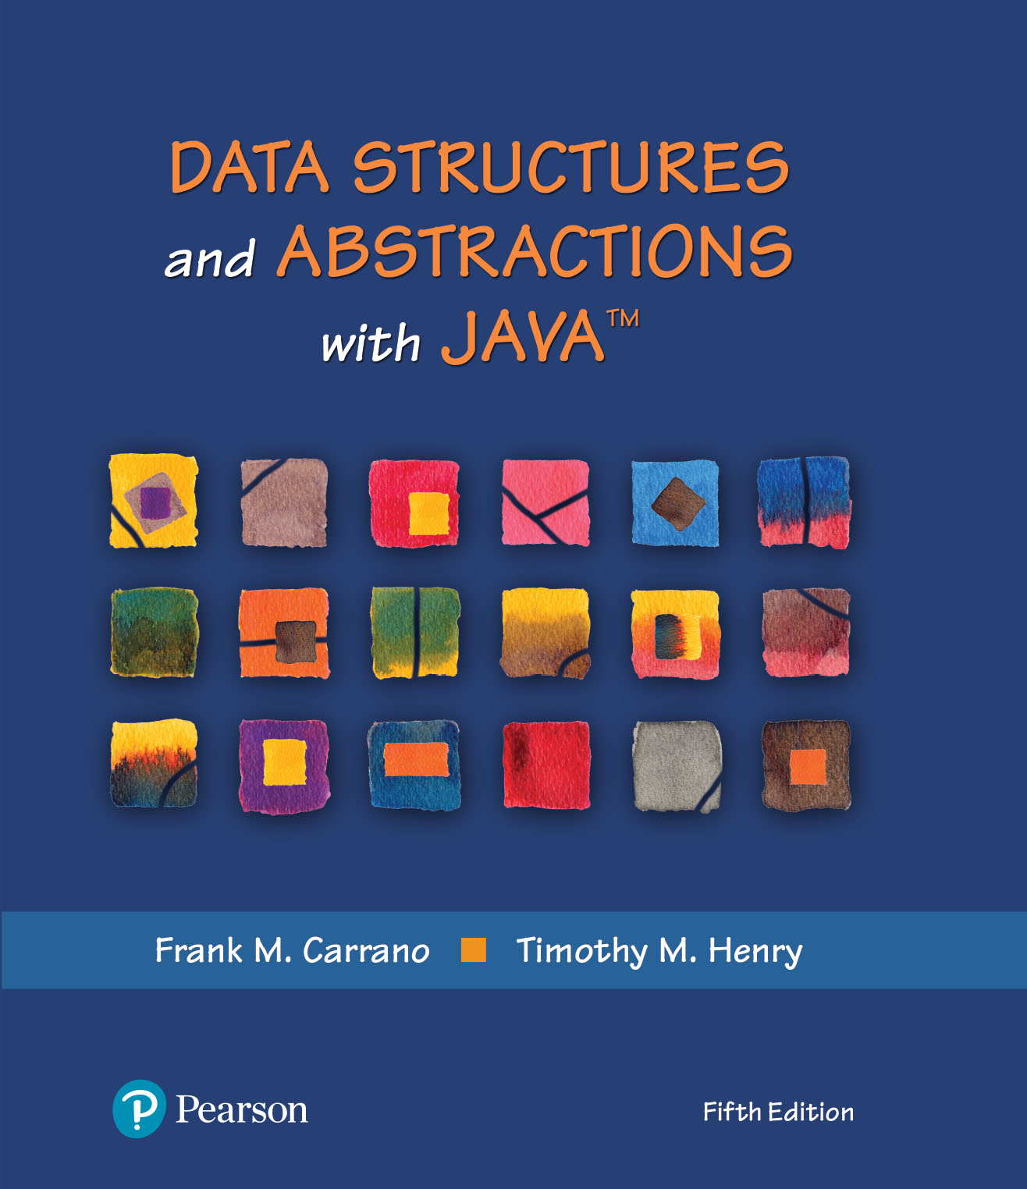
Module 3
Generics

Slide 2
Video Notes
Generics
https://mediaplayer.pearsoncmg.com/assets/secs-vn-JI01-generics
More Generics
https://mediaplayer.pearsoncmg.com/assets/secs-vn-JI05-More-Generics
Generics 3
https://mediaplayer.pearsoncmg.com/assets/secs-vn-JI08-Generics-3
Notes:
To maximize your learning experience, prepare for class prior each week

Slide 3
Generics Resources
Understanding Java Generics (Must Read)
https://blogs.oracle.com/javamagazine/post/understanding-java-generics-part-1-principles-and-fundamentals
https://blogs.oracle.com/javamagazine/post/understanding-java-generics-part-2-the-hard-part
O’Reilly: Understanding Java 8 Generics (Video)
Watch Part 5: Type erasure (as a starting point)
Unavailable on YouTube, but you can access it for free as a MC student
Visit https://www.oreilly.com/library/view/temporary-access/
Select Not listed. Click here. option
Provide your MC email address
Notes:
To maximize your learning experience, prepare for class prior each week

Slide 4
Additional Resources
Java Generics
https://www.youtube.com/watch?v=jUcAyZ5OUm0
Oracle
https://www.oracle.com/technical-resources/articles/java/juneau-generics.html
https://docs.oracle.com/javase/8/docs/technotes/guides/language/generics.html
https://docs.oracle.com/javase/tutorial/java/generics/index.html
https://docs.oracle.com/javase/tutorial/java/generics/QandE/generics-questions.html
Notes:
To maximize your learning experience, prepare for class prior each week

Slide 5
Generics
If you have programmed for a little while in Java, it is likely that you have come across generics, and you have probably used them. (Generics are hard to avoid when using collections, and it is hard to do anything interesting without collections.)
For example, ArrayList<E> is a generic type, where ArrayList is an interface and type parameter E identifies the list's element type
ArrayList<String>
ArrayList<BankAccount>
Notes:
We can specify a generic data type for an interface also

Slide 6
Generic Types (1 of 2)
A generic type is a class or interface that introduces a family of parameterized types by declaring a formal type parameter list (a comma-separated list of type parameter names between angle brackets)
class identifier<formal_type_parameter_list> {} interface identifier<formal_type_parameter_list> {}
Enable you to write a placeholder in lieu of an actual class type
Clients (callers) choose a specific data type during instantiation
Notes:
Source: https://blogs.oracle.com/javamagazine/post/understanding-java-generics-part-1-principles-and-fundamentals
We can specify a generic data type for an interface also

Slide 7
Generic Types (2 of 2)
Example
ArrayList<String>
ArrayList<BankAccount> //BankAccount is a class
ArrayList<Measurable> / / Measurable is an interface
Primitive data types are NOT supported as type variables
ArrayList<double> // no good
ArrayList<Double>
https://docs.oracle.com/en/java/javase/11/docs/api/java.base/java/util/ArrayList.html
Notes:
Q: array vs. ArrayList
ArrayList<Banana> // Banana is a class
ArrayList<Integer>

Slide 8
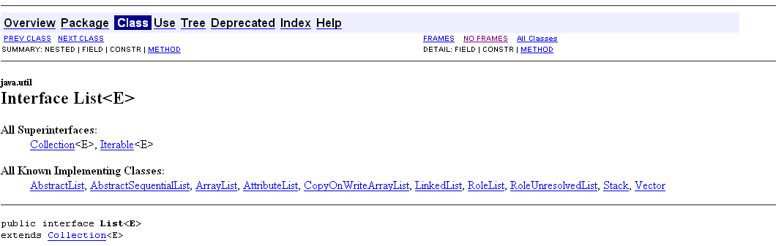
List Interface (Java Class Library)
An ordered collection (also known as a sequence). The user of this interface has precise control over where in the list each element is inserted. The user can access elements by their integer index (position in the list), and search for elements in the list.
Unlike sets, lists typically allow duplicate elements. More formally, lists typically allow pairs of elements e1 and e2 such that e1.equals(e2), and they typically allow multiple null elements if they allow null elements at all. It is not inconceivable that someone might wish to implement a list that prohibits duplicates, by throwing runtime exceptions when the user attempts to insert them, but we expect this usage to be rare
Notes:
Q: Why is List an interface?

Slide 9
Why Generics?
Enabling programmers to implement generic algorithms
Stronger type checks at compile time
Elimination of (type) casts
https://docs.oracle.com/javase/tutorial/java/generics/why.html
Notes:
Without generic, we would need to implement the “same” class multiple times in order to support different data type

Slide 10
Example
/**
An interface for pairs of objects.
*/
public interface Pairable<T>
{
public T getFirst();
public T getSecond();
public void changeOrder();
}
Pairable can support any data type
Notes:
Pairable is a generic interface
Interface vs. class

Slide 11
Example | Generic Class (1 of 2)
/** A class of ordered pairs of objects having the same data type. */
public class OrderedPair<T> implements Pairable<T>
{
private T first, second;
public OrderedPair(T firstItem, T secondItem) // NOTE: no <T> after constructor name
{
first = firstItem;
second = secondItem;
} // end constructor
/** Returns the first object in this pair. */
public T getFirst()
{
return first;
} // end getFirst
An actual class, OrderedPair, is now implemented
Notes:
We are building the OrderedPair class to support any type of data; following the established Pair interface (definition)

Slide 12
Example | Generic Class (2 of 2)
/** Returns the second object in this pair. */
public T getSecond()
{
return second;
} // end getSecond
/** Returns a string representation of this pair. */
public String toString()
{
return "(" + first + ", " + second + ")";
} // end toString
/** Interchanges the objects in this pair. */
public void changeOrder()
{
T temp = first;
first = second;
second = temp;
}
} // end OrderedPair
Q: What if toString() was not implemented?

Slide 13
Standard Type Variable Names
Type Variable | Name Meaning
E | Element type in a collection
K | Key type in a map
V | Value type in a map
T | General type
S, U | Additional general types
E, K, V, T, are just naming conventions only
Notes:
E, K, V & T were used and they make sense
Any characters, such as, A, B, C & D, could have been used. You should follow the “standard” naming conventions

Slide 14
Comparing Two Objects
Why do we need to compare?
Is “a” greater than “b”?
int a, b;
Apple c, b;
Is “a” better than “b”?
“better” vs. “bigger”
Notes:
For two integer values, we know what greater means
For two apples, it’s as obvious
In fact, the compiler does not know what to do

Slide 15
Interface Comparable
public interface Comparable<T>
{
public int compareTo(T other);
} // end Comparable
By implementing compareTo(), two objects of the class T can now be compared
You decide how to compare
The interface java.lang.Comparable
Is “s” better than “t”?
Consider the method compareTo for class String
if s and t are strings, s.compareTo(t) is
Negative value if s comes before t
Zero if s and t are equal
Positive value if s comes after t
Notes:
To compare two objects, we need to implement a “compare” method
Is “s” better than “t”? We need to specify what “better” means

Slide 16
Class Circle | Example
How do we compare two circle objects?
public class Circle implements Comparable<Circle>
{
private double radius;
// Definitions of constructors and methods are here.
// . . .
public int compareTo(Circle other)
{
int result;
if (this.equals(other))
result = 0;
else if (radius < other.radius)
result = -1;
else
result = 1;
return result;
}
} // end Circle
Notes:
To compare two circles (objects,) we will need to implement the compareTo()
We are able to utilize the < operator because radius is a double
Example: What’s better, Planet Sun or Venus?

Slide 17
Coin | Another Example
You can implement Comparable interface for your own classes:
public class Coin implements Comparable<Coin> { ... public int compareTo(Coin otherObject) { Coin other = (Coin)otherObject; if (value < other.value) return -1; if (value == other.value) return 0; return 1; } ... }

Slide 18
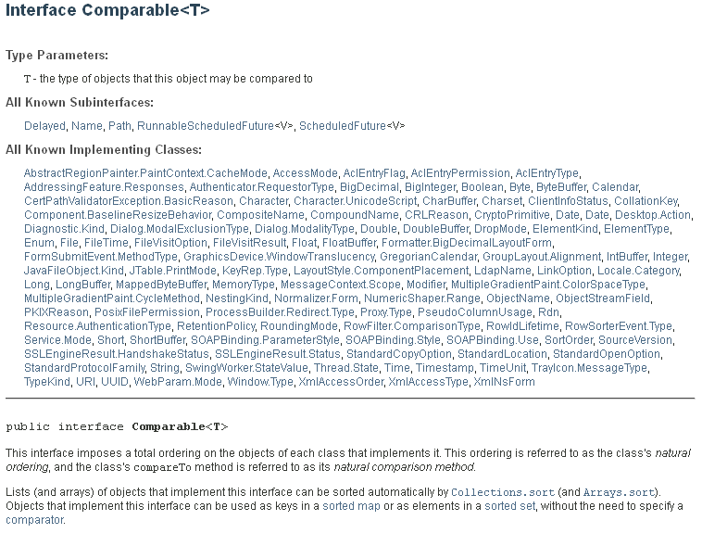

Slide 19
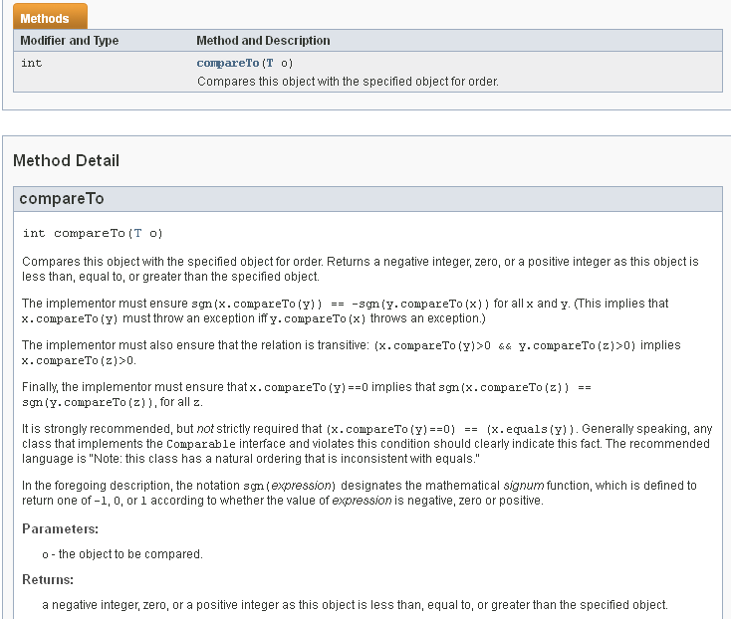

Slide 20
Bounded Type Parameters
We want to write a static method that returns the smallest object in an array. Suppose that we wrote our method shown here:
// First draft | this is INCORRECT
public MyClass
{
public static <T> T arrayMinimum(T[] anArray)
{
T minimum = anArray[0];
for (T arrayEntry : anArray)
{
if (arrayEntry.compareTo(minimum) < 0)
minimum = arrayEntry;
} // end for
return minimum;
} // end arrayMinimum
} // end MyClass
Q: What’s wrong?
Syntax error
Notes:
This is a generic method
Why do we need compareTo()?

Slide 21
Bounded Type Parameters
Header really should be as shown
public MyClass
{
public static <T extends Comparable<T>> T arrayMinimum(T[] anArray)
{
T minimum = anArray[0];
for (T arrayEntry : anArray)
{
if (arrayEntry.compareTo(minimum) < 0)
minimum = arrayEntry;
} // end for
return minimum;
} // end arrayMinimum
// . . .
} // end MyClass
Notes:
Need to learn the syntax
We are saying that we are using an interface Comparable

Slide 22
Comparing Two Objects
.equals() vs. == vs. compareTo()
Use == operators for reference comparison (address comparison) and .equals() method for content comparison
== checks if both objects point to the same memory location whereas .equals() evaluates to the comparison of values in the objects
https://www.geeksforgeeks.org/difference-equals-method-java/
Notes:
Read this article

Slide 23
Example (Geeksforgeeks.org)
public class Test {
public static void main(String[] args)
{
String s1 = "HELLO";
String s2 = "HELLO";
String s3 = new String("HELLO");
System.out.println(s1 == s2); // true
System.out.println(s1 == s3); // false
System.out.println(s1.equals(s2)); // true
System.out.println(s1.equals(s3)); // true
}
}
Notes:
https://www.geeksforgeeks.org/difference-between-and-equals-method-in-java/
Do you know why? Read article …

Slide 24
Wildcards
Question mark, ?, is used to represent an unknown class type
Referred to as a wildcard
Consider following method and objects
Method displayPair() will accept as an argument a pair of objects whose data type is a class (any class)
public static void displayPair(OrderedPair<?> pair)
{
System.out.println(pair);
} // end displayPair
OrderedPair<String> aPair = new OrderedPair<>("apple", "banana");
OrderedPair<Integer> anotherPair = new OrderedPair<>(1, 2);
displayPair(aPair);
displayPair(anotherPair);
Notes:
Checkout below two generics references
https://www.geeksforgeeks.org/wildcards-in-java/
public static void add(List<? extends Number> list)
https://docs.oracle.com/javase/8/docs/api/java/lang/Number.html
https://www.baeldung.com/java-generics-interview-questions
<? extends …> // higher, beyond
<? Super …> // lower

Slide 25
Multiple Generic Types
public class Pair<S, T>
{
private S first;
private T second;
public Pair(S firstItem, T secondItem)
{
first = firstItem;
second = secondItem;
} // end constructor
public String toString()
{
return "(" + first + ", " + second + ")";
}
} // end Pair
S & T means that they are two different (generic) data types
Notes:
A pair of values of different types

Slide 26
Multiple Generic Types
Each represents actual data type specified by the client when it instantiates object of the class
Example | class Pair
Name joe = new Name("Joe", "Java");
String joePhone = "(401) 555-1234";
Pair<Name, String> joeEntry = new Pair<>(joe, joePhone);
System.out.println(joeEntry);
Notes:
“joe” and “joePhone” are two different types

Slide 27
Generic Methods
Generic method: method with a type variable
Can be defined inside non-generic classes
Example: Want to declare a method that can print an array of any type:
public class ArrayUtil
{
/**
Prints all elements in an array.
@param a the array to print
*/
public static <T> void print(T[] a)
{
. . .
}
. . .
}
Notes:
We can implement generic methods (for a class,) instead of creating a generic class
Be mindful about the generic method’s syntax

Slide 28
Implement a Generic Method (1 of 3)
Often easier to see how to implement a generic method by starting with a concrete example; e.g. print the elements in an array of strings:
public class ArrayUtil
{
public static void print(String[] a) { for (String e : a) System.out.print(e + " "); System.out.println();
}
. . . }
Notes:
It’s a good idea to start implementing something specific first; then change it to a generic method

Slide 29
Implement a Generic Method (2 of 3)
In order to make the method into a generic method:
Replace String with a type parameter, say E, to denote the element type
Supply the type parameters between the method's modifiers and return type
public static <E> void print(E[] a)
{
for (E e : a)
System.out.print(e + " ");
System.out.println();
}
Notes:
Why E and not T?
Syntax of a generic method
public static <E> void print(E[] a) { … }

Slide 30
Implement a Generic Method (3 of 3)
When calling a generic method, you need not instantiate the type variables:
Rectangle[] rectangles = . . .; ArrayUtil.print(rectangles);
The compiler deduces that E is Rectangle
You can also define generic methods that are not static
Cannot replace type variables with primitive types
e.g., cannot use the generic print method to print an array of type int[]

Slide 31
Activity
public class driver {
public static <T> void displayArray(T[] anArray) {
// implement your code here
}
public static void main(String[] args) { String[] stringArray = { "apple", "banana", "carrot", "orange" };
System.out.print("stringArray contains: \n");
displayArray(stringArray);
Integer[] intArray = {2, 4, 6, 8, 10, 12};
System.out.print("\nintArray contains: \n");
displayArray(intArray);
}
}

Slide 32
Activity | Solutiion
public class driver {
public static <T> void displayArray(T[] anArray) {
for(T a: anArray) {
System.out.println(a);
}
}
public static void main(String[] args) {
String[] stringArray = { "apple", "banana", "carrot", "orange" };
System.out.print("stringArray contains: \n");
displayArray(stringArray);
Integer[] intArray = {2, 4, 6, 8, 10, 12};
System.out.print("\nintArray contains: \n");
displayArray(intArray);
}
}

Slide 33
Type Erasure

Slide 34
Type Erasure
Internally, inside the JVM, this is how Generics work
Generic class Pair<T, S> turns into the following raw class:
public class Pair {
private Object first; private Object second;
public Pair(Object firstElement, Object secondElement) { first = firstElement; second = secondElement; } public Object getFirst() { return first; } public Object getSecond() { return second; } }
Notes:
It can be a challenge to fix a generic error, including a (generic) syntax error
What’s the problem then?

Slide 35
Type Erasure
The virtual machine erases type parameters, replacing them with their bounds or Objects
Type parameters exist only at compile time; they are completely removed at runtime
They are a construct exclusively used for type checking during compilation to ensure type safety, but they are not carried through into the Java bytecode
https://blogs.oracle.com/javamagazine/post/understanding-java-generics-part-2-the-hard-part
Notes:
It can be a challenge to fix a generic error, including a (generic) syntax error
What’s the problem then?
https://blogs.oracle.com/javamagazine/post/understanding-java-generics-part-2-the-hard-part

Slide 36
Type Erasure
Knowing raw types helps you understand generics’ limitations
For example, trying to fill an array with copies of objects would be wrong:
public static <T> void fillWithDefaults(T[] a)
{
for (int i = 0; i < a.length; i++)
a[i] = new T();
}
Type erasure yields:
public static void fillWithDefaults(Object[] a)
{
for (int i = 0; i < a.length; i++)
a[i] = new Object(); // Not useful
}
Notes:
Be mindful if you are doing a “new” inside a generic

Slide 37
Type Erasure
To solve this particular problem, you can supply a default value:
public static <E> void fillWithDefaults(E[] a,
E defaultValue)
{
for (int i = 0; i < a.length; i++)
a[i] = defaultValue;
}
This would have already been constructed

Slide 38
Type Erasure
You cannot construct an array of a generic type:
public class Group<E>
{
private E[] elements;
. . .
public Group()
{
// Error, would construct Object objects
elements = new E[MAX_SIZE]; }
}
How is this different?
public static <E> void print(E[] a)
{
for (E e : a)
System.out.print(e + " ");
System.out.println();
}
This array is being passed in and it has already been
constructed

Slide 39
Type Erasure
One remedy is to use an array list instead:
public class Group<E>
{
private ArrayList<E> elements;
. . .
public Group()
{
elements = new ArrayList<E>(); // Ok
}
}

